Slide 1
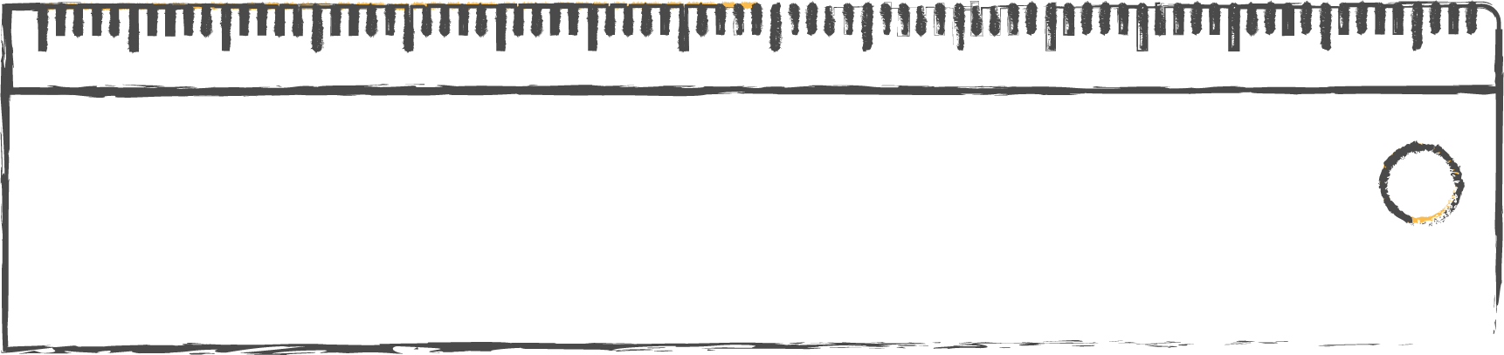
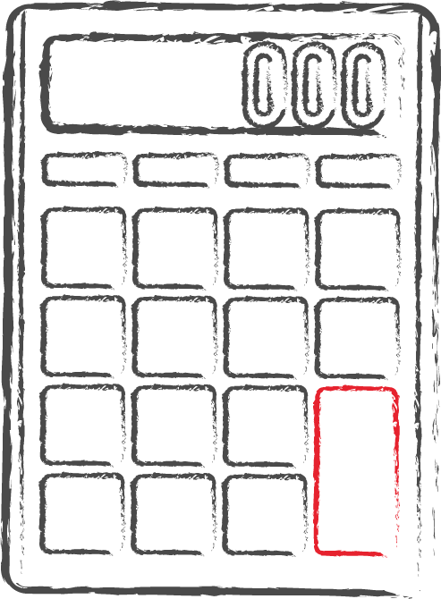

Areas Of Bounded Regions
- Mathematics -
12th grade
DAV PUBLIC SCHOOLS BIHAR ZONE
By- Dr. N.K Verma

Slide 2
TOPICS TO BE COVERED
1
3
Area Using Horizontal Stripe’s
4
Area as a Definite Integral
2
Questions
5
Questions
Area Using Vertical Stripe’s

Slide 3
01
Area as a Definite Integral

Slide 4
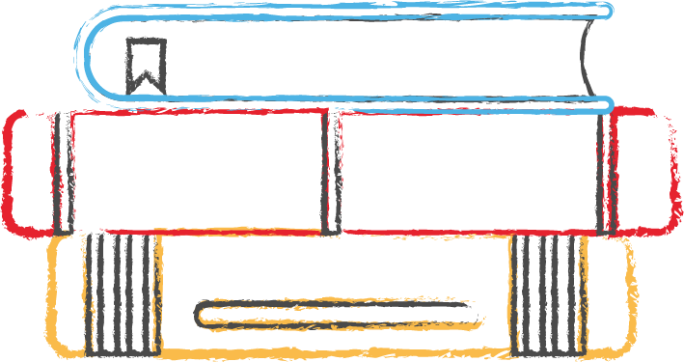
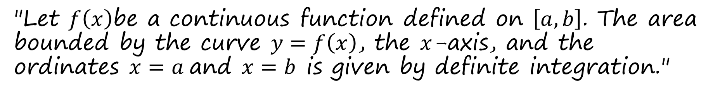
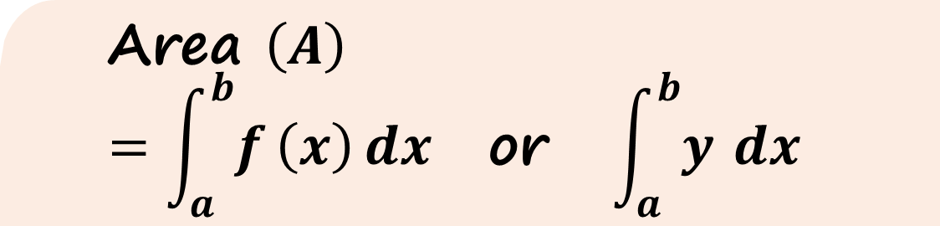
Theorem Statement
"Let $f\left(x\right)$be a continuous function defined on $\left[a,b\right]$. The area bounded by the curve $y=f\left(x\right)$, the $x$-axis, and the ordinates $x=a$and $x=b$is given by definite integration."
Mathematical Representation
$$\text{Area }\left(A\right)=\int_{a}^{b}{f}\left(x\right) dx \text{or} \int_{a}^{b}{y} dx$$

Slide 5
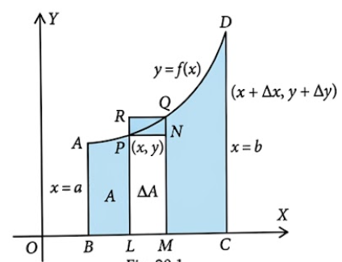
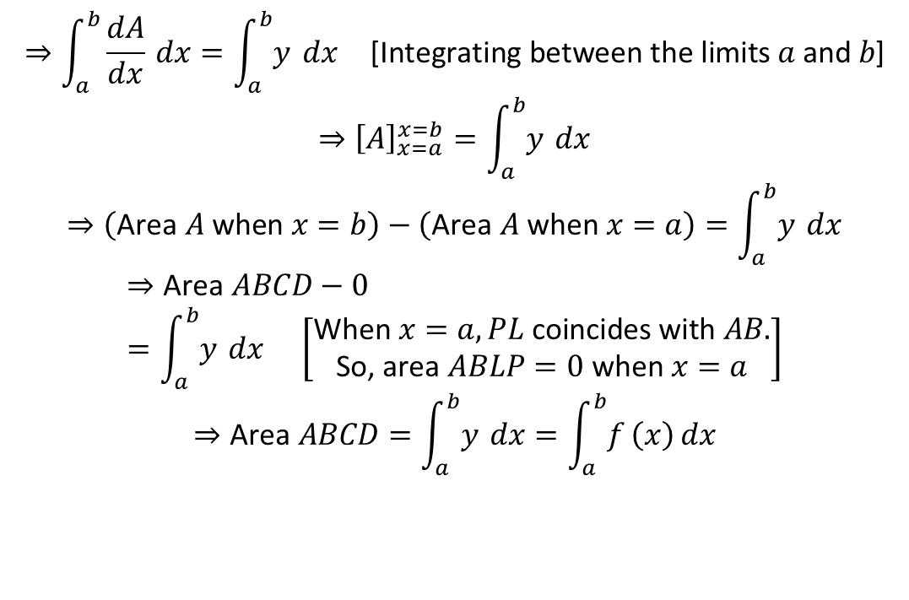
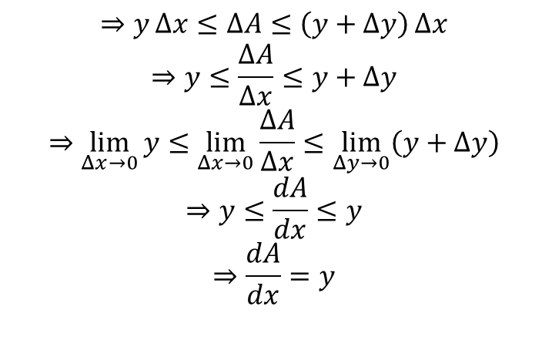
Proof
Let AD be the curve y =f(x) between the ordinates BA (x = a) and CD (x = b). Then, the required area is the area of region ABCD. Let P(x,y) be any point on the curve and Q(x+ Ax, y + Ay) be a neighbouring point on it. Draw ordinates PL and QM. Then, PL = y, QM =y + Ay and LM = Aх.
Let A denote the Area BLPA, and let A + AA be the Area BMQA. Then, AA = Area LMQP. Also, Area LMNP = y Ax, and Area LMQR =(y + Ay) Aх. Clearly, Area of rectangle LMNP < Area LMQP ≤ Area of rectangle LMQR
$$⇒\int_{a}^{b}{\frac{dA}{dx}} dx=\int_{a}^{b}{y} dx \text{[Integrating between the limits }a\text{ and }b\text{]}$$
$$⇒{\left[A\right]}_{x=a}^{x=b}=\int_{a}^{b}{y} dx$$
$$⇒\left(\text{Area }A\text{ when }x=b\right)−\left(\text{Area }A\text{ when }x=a\right)=\int_{a}^{b}{y} dx$$
$$⇒\text{Area }ABCD−0=\int_{a}^{b}{y} dx \left[\begin{aligned}\text{When }x=a,PL\text{ coincides with }AB. \\ \text{So, area }ABLP=0\text{ when }x=a\end{aligned}\right]$$
$$⇒\text{Area }ABCD=\int_{a}^{b}{y} dx=\int_{a}^{b}{f}\left(x\right) dx$$
$$⇒y Δx≤ΔA≤\left(y+Δy\right) Δx$$
$$⇒y≤\frac{ΔA}{Δx}≤y+Δy$$
$$⇒\lim_{Δx→0}{y}≤\lim_{Δx→0}{\frac{ΔA}{Δx}}≤\lim_{Δy→0}\left(y+Δy\right)$$
$$⇒y≤\frac{dA}{dx}≤y$$
$$⇒\frac{dA}{dx}=y$$

Slide 6
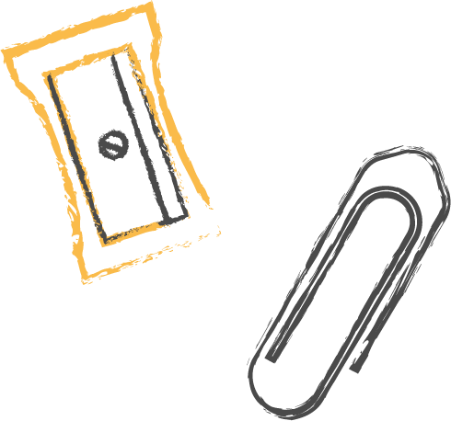
02
Area Using Vertical Stripe’s

Slide 7
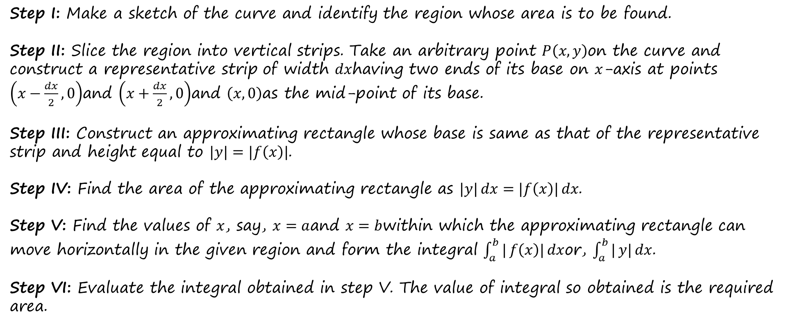
In order to find the area of the region bounded by the curve $y=f\left(x\right)$, $x$-axis and the ordinates $x=a$and $x=b$, we may use the following algorithm.
ALGORITHM
Step I: Make a sketch of the curve and identify the region whose area is to be found.
Step II: Slice the region into vertical strips. Take an arbitrary point $P\left(x,y\right)$on the curve and construct a representative strip of width $dx$having two ends of its base on $x$-axis at points $\left(x−\frac{dx}{2},0\right)$and $\left(x+\frac{dx}{2},0\right)$and $\left(x,0\right)$as the mid-point of its base.
Step III: Construct an approximating rectangle whose base is same as that of the representative strip and height equal to $|y|=|f\left(x\right)|$.
Step IV: Find the area of the approximating rectangle as $|y| dx=|f\left(x\right)| dx$.
Step V: Find the values of $x$, say, $x=a$and $x=b$within which the approximating rectangle can move horizontally in the given region and form the integral $\int_{a}^{b}{|}f\left(x\right)| dx$or, $\int_{a}^{b}{|}y| dx$.
Step VI: Evaluate the integral obtained in step V. The value of integral so obtained is the required area.

Slide 8
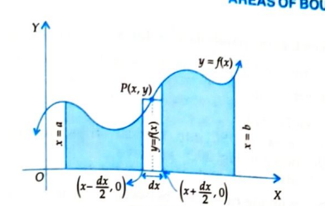
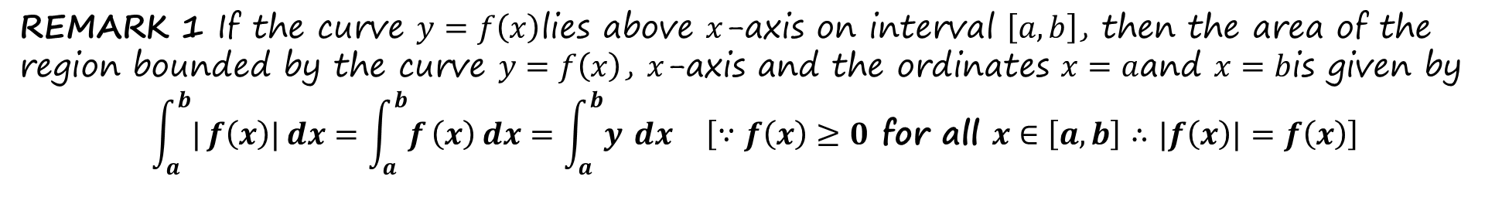
REMARKS
REMARK 1 If the curve $y=f\left(x\right)$lies above $x$-axis on interval $\left[a,b\right]$, then the area of the region bounded by the curve $y=f\left(x\right)$, $x$-axis and the ordinates $x=a$and $x=b$is given by
$$\int_{a}^{b}{|}f\left(x\right)| dx=\int_{a}^{b}{f}\left(x\right) dx=\int_{a}^{b}{y} dx \left[∵f\left(x\right)≥0\text{ for all }x∈\left[a,b\right]∴|f\left(x\right)|=f\left(x\right)\right]$$

Slide 9
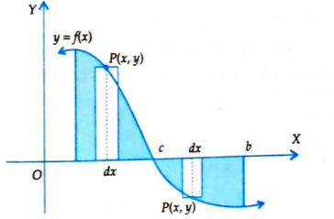
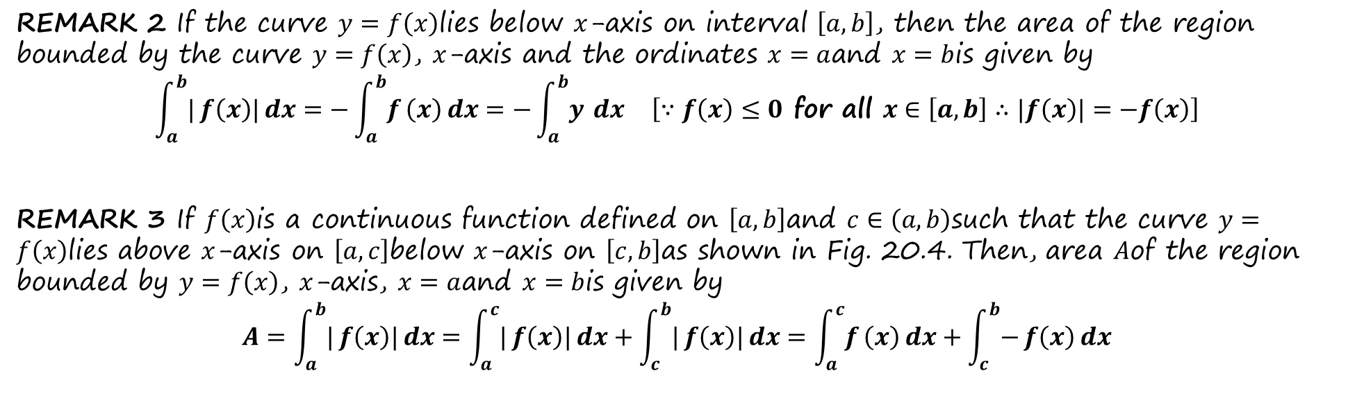
REMARK 2 If the curve $y=f\left(x\right)$lies below $x$-axis on interval $\left[a,b\right]$, then the area of the region bounded by the curve $y=f\left(x\right)$, $x$-axis and the ordinates $x=a$and $x=b$is given by
$$\int_{a}^{b}{|}f\left(x\right)| dx=−\int_{a}^{b}{f}\left(x\right) dx=−\int_{a}^{b}{y} dx \left[∵f\left(x\right)≤0\text{ for all }x∈\left[a,b\right]∴|f\left(x\right)|=−f\left(x\right)\right]$$
REMARK 3 If $f\left(x\right)$is a continuous function defined on $\left[a,b\right]$and $c∈\left(a,b\right)$such that the curve $y=f\left(x\right)$lies above $x$-axis on $\left[a,c\right]$below $x$-axis on $\left[c,b\right]$as shown in Fig. 20.4. Then, area $A$of the region bounded by $y=f\left(x\right)$, $x$-axis, $x=a$and $x=b$is given by
$$A=\int_{a}^{b}{|}f\left(x\right)| dx=\int_{a}^{c}{|}f\left(x\right)| dx+\int_{c}^{b}{|}f\left(x\right)| dx=\int_{a}^{c}{f}\left(x\right) dx+\int_{c}^{b}{−}f\left(x\right) dx$$

Slide 10
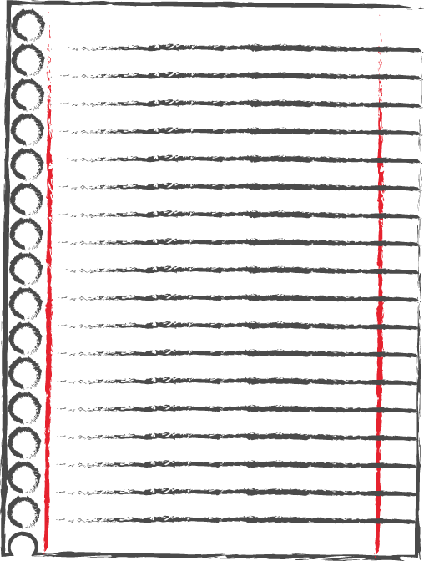

03
Questions

Slide 11
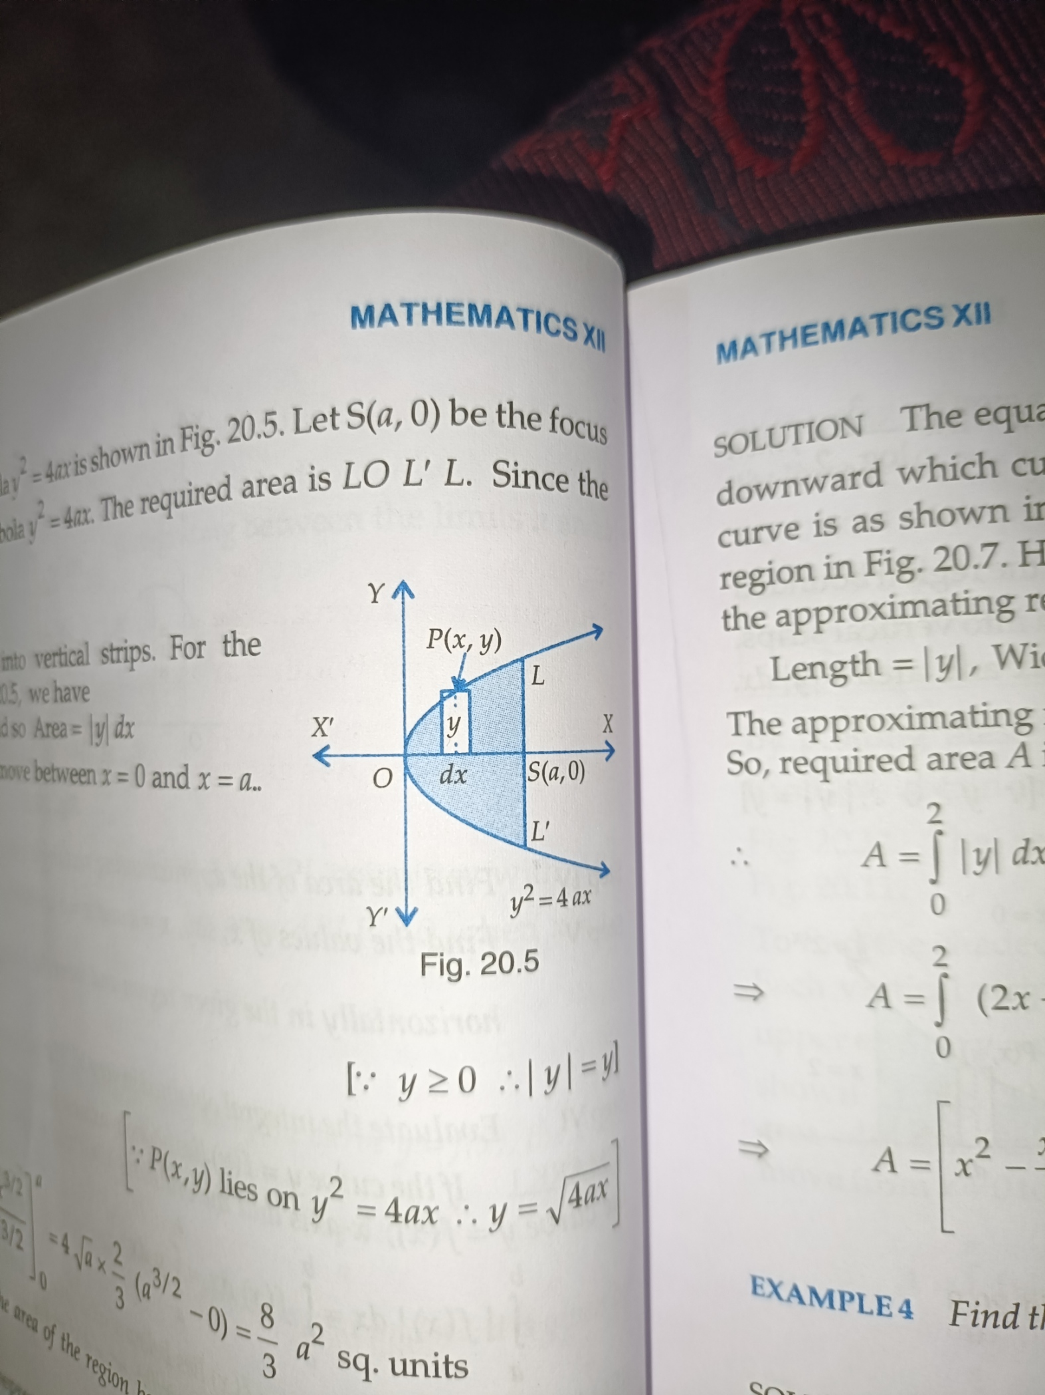
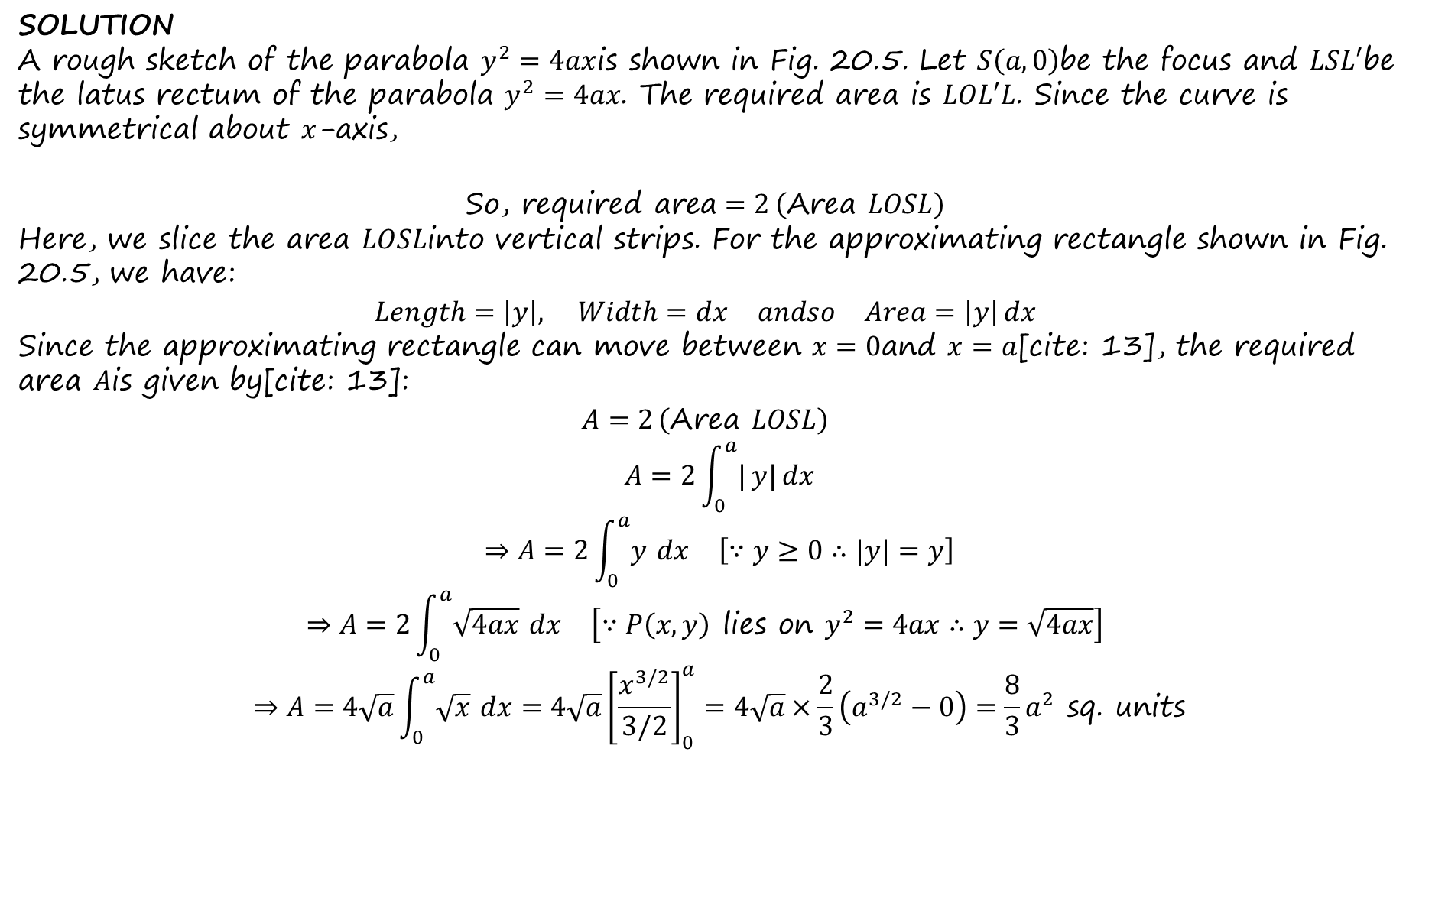
Using integration, find the area of the region bounded between the line $x=4$and the parabola $y^{2}=16x$.
SOLUTION
A rough sketch of the parabola $y^{2}=4ax$is shown in Fig. 20.5. Let $S\left(a,0\right)$be the focus and $LSL′$be the latus rectum of the parabola $y^{2}=4ax$. The required area is $LOL′L$. Since the curve is symmetrical about $x$-axis,
$$\text{So, required area}=2 \left(\text{Area }LOSL\right)$$
Here, we slice the area $LOSL$into vertical strips. For the approximating rectangle shown in Fig. 20.5, we have:
$$Length=\left|y\right|, Width=dx andso Area=\left|y\right| dx$$
Since the approximating rectangle can move between $x=0$and $x=a$[cite: 13], the required area $A$is given by[cite: 13]:
$$A=2 \left(\text{Area }LOSL\right)$$
$$A=2\int_{0}^{a}{|}y| dx$$
$$⇒A=2\int_{0}^{a}{y} dx \left[∵y≥0∴|y|=y\right]$$
$$⇒A=2\int_{0}^{a}{\sqrt{4ax}} dx \left[∵P\left(x,y\right)\text{ lies on }y^{2}=4ax∴y=\sqrt{4ax}\right]$$
$$⇒A=4\sqrt{a}\int_{0}^{a}{\sqrt{x}} dx=4\sqrt{a}{\left[\frac{x^{3/2}}{3/2}\right]}_{0}^{a}=4\sqrt{a}×\frac{2}{3}\left(a^{3/2}−0\right)=\frac{8}{3}a^{2}\text{ sq. units}$$

Slide 12
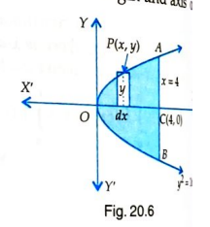
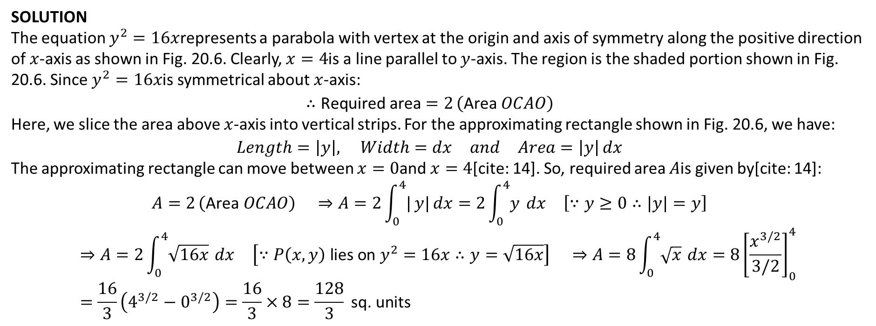
Find the area bounded by the parabola y² = 4ax and its latus rectum.
SOLUTION
The equation $y^{2}=16x$represents a parabola with vertex at the origin and axis of symmetry along the positive direction of $x$-axis as shown in Fig. 20.6. Clearly, $x=4$is a line parallel to $y$-axis. The region is the shaded portion shown in Fig. 20.6. Since $y^{2}=16x$is symmetrical about $x$-axis:
$$∴\text{Required area}=2 \left(\text{Area }OCAO\right)$$
Here, we slice the area above $x$-axis into vertical strips. For the approximating rectangle shown in Fig. 20.6, we have:
$$Length=\left|y\right|, Width=dx and Area=\left|y\right| dx$$
The approximating rectangle can move between $x=0$and $x=4$[cite: 14]. So, required area $A$is given by[cite: 14]:
$$A=2 \left(\text{Area }OCAO\right) ⇒A=2\int_{0}^{4}{|}y| dx=2\int_{0}^{4}{y} dx \left[∵y≥0∴|y|=y\right]$$
$$⇒A=2\int_{0}^{4}{\sqrt{16x}} dx \left[∵P\left(x,y\right)\text{ lies on }y^{2}=16x∴y=\sqrt{16x}\right] ⇒A=8\int_{0}^{4}{\sqrt{x}} dx=8{\left[\frac{x^{3/2}}{3/2}\right]}_{0}^{4}=\frac{16}{3}\left(4^{3/2}−0^{3/2}\right)=\frac{16}{3}×8=\frac{128}{3}\text{ sq. units}$$

Slide 13
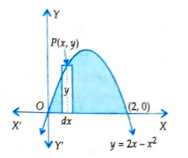
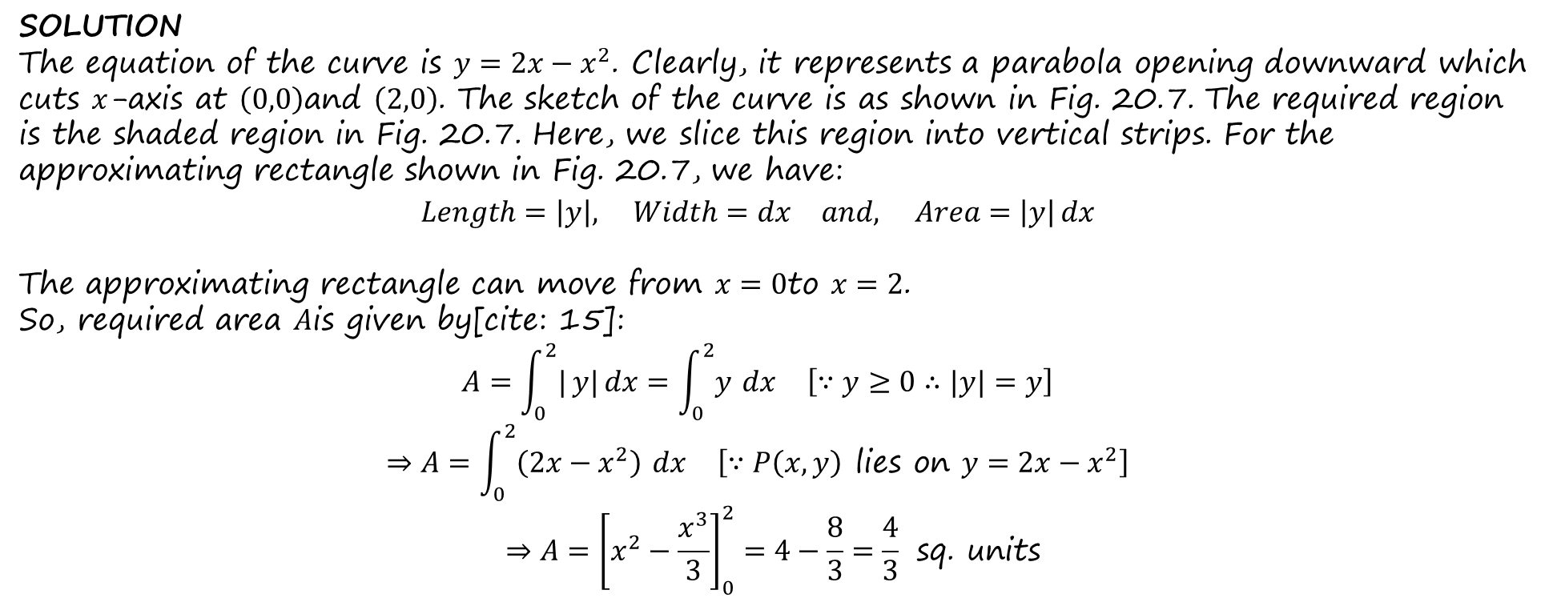
Sketch the region bounded by y = 2x -x² and x-axis and find its area using integration
SOLUTION
The equation of the curve is $y=2x−x^{2}$. Clearly, it represents a parabola opening downward which cuts $x$-axis at $\left(0,0\right)$and $\left(2,0\right)$. The sketch of the curve is as shown in Fig. 20.7. The required region is the shaded region in Fig. 20.7. Here, we slice this region into vertical strips. For the approximating rectangle shown in Fig. 20.7, we have:
$$Length=\left|y\right|, Width=dx and, Area=\left|y\right| dx$$
The approximating rectangle can move from $x=0$to $x=2$.
So, required area $A$is given by[cite: 15]:
$$A=\int_{0}^{2}{|}y| dx=\int_{0}^{2}{y} dx \left[∵y≥0∴|y|=y\right]$$
$$⇒A=\int_{0}^{2}{\left(2x−x^{2}\right)} dx \left[∵P\left(x,y\right)\text{ lies on }y=2x−x^{2}\right]$$
$$⇒A={\left[x^{2}−\frac{x^{3}}{3}\right]}_{0}^{2}=4−\frac{8}{3}=\frac{4}{3}\text{ sq. units}$$

Slide 14
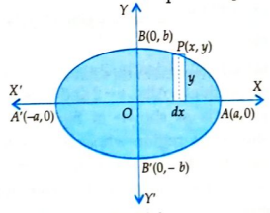
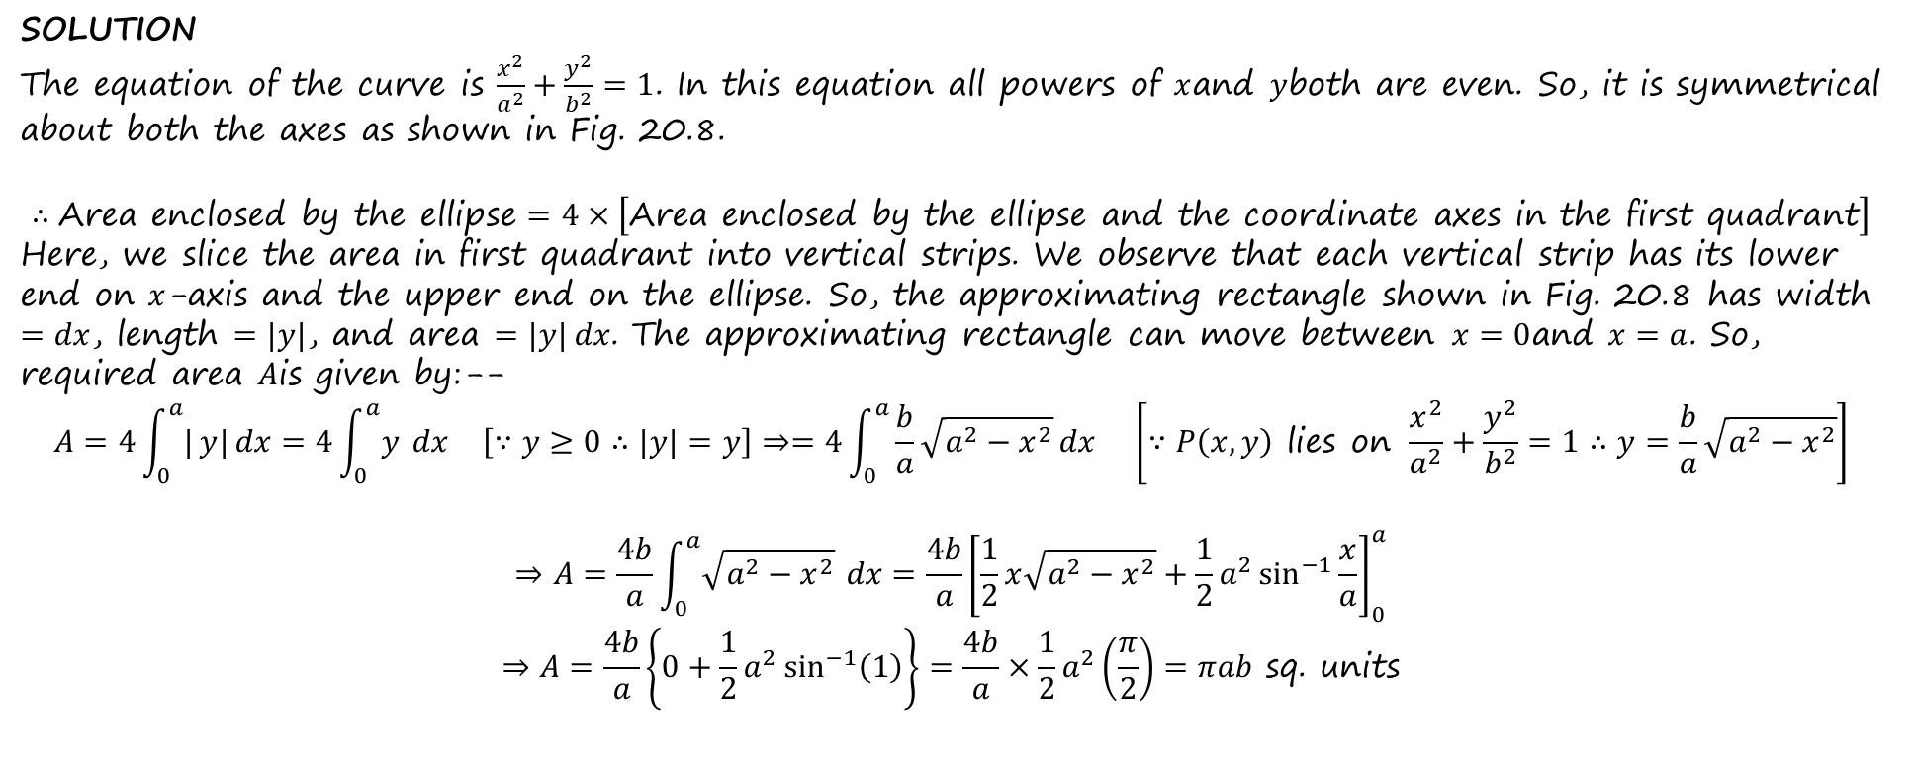
Find the area of the region bounded by the ellipse $\frac{x^{2}}{a^{2}}+\frac{y^{2}}{b^{2}}=1$[NCERT].
SOLUTION
The equation of the curve is $\frac{x^{2}}{a^{2}}+\frac{y^{2}}{b^{2}}=1$. In this equation all powers of $x$and $y$both are even. So, it is symmetrical about both the axes as shown in Fig. 20.8.
$$∴\text{Area enclosed by the ellipse}=4×\left[\text{Area enclosed by the ellipse and the coordinate axes in the first quadrant}\right]$$
Here, we slice the area in first quadrant into vertical strips. We observe that each vertical strip has its lower end on $x$-axis and the upper end on the ellipse. So, the approximating rectangle shown in Fig. 20.8 has width $=dx$, length $=|y|$, and area $=|y| dx$. The approximating rectangle can move between $x=0$and $x=a$. So, required area $A$is given by:--
$$A=4\int_{0}^{a}{|}y| dx=4\int_{0}^{a}{y} dx \left[∵y≥0∴|y|=y\right]⇒=4\int_{0}^{a}{\frac{b}{a}}\sqrt{a^{2}−x^{2}} dx \left[∵P\left(x,y\right)\text{ lies on }\frac{x^{2}}{a^{2}}+\frac{y^{2}}{b^{2}}=1∴y=\frac{b}{a}\sqrt{a^{2}−x^{2}}\right]$$
$$⇒A=\frac{4b}{a}\int_{0}^{a}{\sqrt{a^{2}−x^{2}}} dx=\frac{4b}{a}{\left[\frac{1}{2}x\sqrt{a^{2}−x^{2}}+\frac{1}{2}a^{2}\sin^{−1}{\frac{x}{a}}\right]}_{0}^{a}$$
$$⇒A=\frac{4b}{a}\left\{0+\frac{1}{2}a^{2}\sin^{−1}\left(1\right)\right\}=\frac{4b}{a}×\frac{1}{2}a^{2}\left(\frac{π}{2}\right)=πab\text{ sq. units}$$

Slide 15
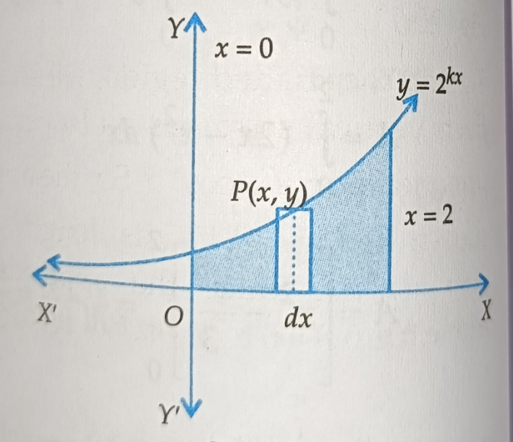
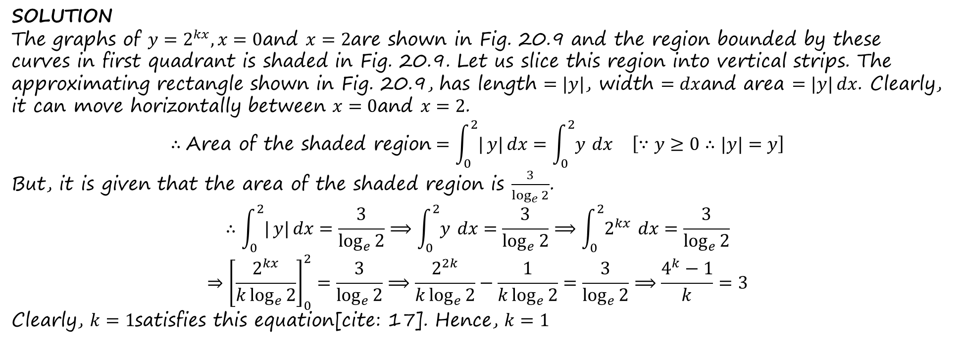
Question: If the area above $x$-axis, bounded by the curves $y=2^{kx}$and $x=0$and $x=2$is $\frac{3}{\log_{e}{2}}$, then find the value of $k$.
SOLUTION
The graphs of $y=2^{kx},x=0$and $x=2$are shown in Fig. 20.9 and the region bounded by these curves in first quadrant is shaded in Fig. 20.9. Let us slice this region into vertical strips. The approximating rectangle shown in Fig. 20.9, has length $=|y|$, width $=dx$and area $=|y| dx$. Clearly, it can move horizontally between $x=0$and $x=2$.
$$∴\text{Area of the shaded region}=\int_{0}^{2}{|}y| dx=\int_{0}^{2}{y} dx \left[∵y≥0∴|y|=y\right]$$
But, it is given that the area of the shaded region is $\frac{3}{\log_{e}{2}}$.
$$∴\int_{0}^{2}{|}y| dx=\frac{3}{\log_{e}{2}}⟹\int_{0}^{2}{y} dx=\frac{3}{\log_{e}{2}}⟹\int_{0}^{2}{2^{kx}} dx=\frac{3}{\log_{e}{2}}$$
$$⇒{\left[\frac{2^{kx}}{k\log_{e}{2}}\right]}_{0}^{2}=\frac{3}{\log_{e}{2}}⟹\frac{2^{2k}}{k\log_{e}{2}}−\frac{1}{k\log_{e}{2}}=\frac{3}{\log_{e}{2}}⟹\frac{4^{k}−1}{k}=3$$
Clearly, $k=1$satisfies this equation[cite: 17]. Hence, $k=1$

Slide 16
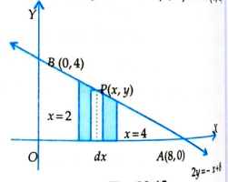
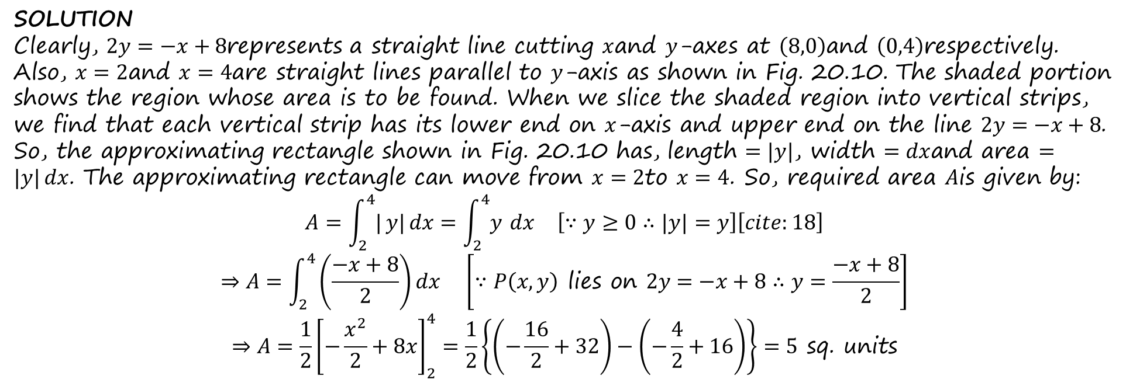
Question: Using integration, find the area of the region bounded by the line $2y=−x+8$, $x$-axis and the lines $x=2$and $x=4$.
SOLUTION
Clearly, $2y=−x+8$represents a straight line cutting $x$and $y$-axes at $\left(8,0\right)$and $\left(0,4\right)$respectively. Also, $x=2$and $x=4$are straight lines parallel to $y$-axis as shown in Fig. 20.10. The shaded portion shows the region whose area is to be found. When we slice the shaded region into vertical strips, we find that each vertical strip has its lower end on $x$-axis and upper end on the line $2y=−x+8$. So, the approximating rectangle shown in Fig. 20.10 has, length $=|y|$, width $=dx$and area $=|y| dx$. The approximating rectangle can move from $x=2$to $x=4$. So, required area $A$is given by:
$$A=\int_{2}^{4}{|}y| dx=\int_{2}^{4}{y} dx \left[∵y≥0∴|y|=y\right]\left[cite:18\right]$$
$$⇒A=\int_{2}^{4}{\left(\frac{−x+8}{2}\right)}dx \left[∵P\left(x,y\right)\text{ lies on }2y=−x+8∴y=\frac{−x+8}{2}\right]$$
$$⇒A=\frac{1}{2}{\left[−\frac{x^{2}}{2}+8x\right]}_{2}^{4}=\frac{1}{2}\left\{\left(−\frac{16}{2}+32\right)−\left(−\frac{4}{2}+16\right)\right\}=5\text{ sq. units}$$

Slide 17
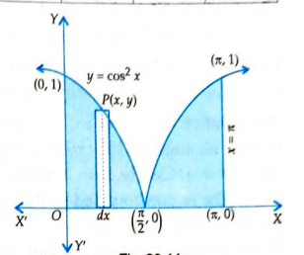
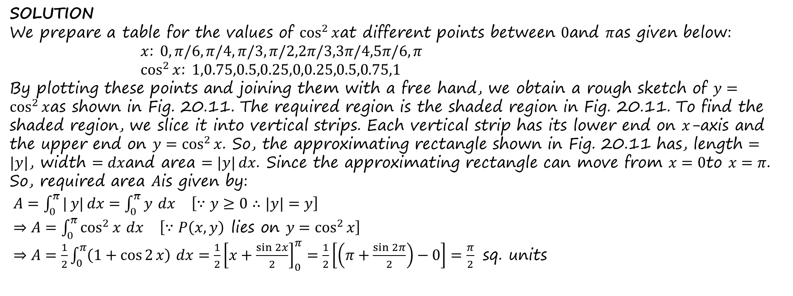
Question: Draw a rough sketch of the curve $y=\cos^{2}{x}$in $\left[0,π\right]$and find the area enclosed by the curve, the lines $x=0,x=π$and the $x$-axis.
SOLUTION
We prepare a table for the values of $\cos^{2}{x}$at different points between $0$and $π$as given below:
$x$: $0,π/6,π/4,π/3,π/2,2π/3,3π/4,5π/6,π$
$\cos^{2}{x}$: $1,0.75,0.5,0.25,0,0.25,0.5,0.75,1$
By plotting these points and joining them with a free hand, we obtain a rough sketch of $y=\cos^{2}{x}$as shown in Fig. 20.11. The required region is the shaded region in Fig. 20.11. To find the shaded region, we slice it into vertical strips. Each vertical strip has its lower end on $x$-axis and the upper end on $y=\cos^{2}{x}$. So, the approximating rectangle shown in Fig. 20.11 has, length $=|y|$, width $=dx$and area $=|y| dx$. Since the approximating rectangle can move from $x=0$to $x=π$. So, required area $A$is given by:
$A=\int_{0}^{π}{|}y| dx=\int_{0}^{π}{y} dx \left[∵y≥0∴|y|=y\right]$
$⇒A=\int_{0}^{π}{\cos^{2}{x}} dx \left[∵P\left(x,y\right)\text{ lies on }y=\cos^{2}{x}\right]$
$⇒A=\frac{1}{2}\int_{0}^{π}{\left(1+\cos{2}x\right)} dx=\frac{1}{2}{\left[x+\frac{\sin{2}x}{2}\right]}_{0}^{π}=\frac{1}{2}\left[\left(π+\frac{\sin{2}π}{2}\right)−0\right]=\frac{π}{2}\text{ sq. units}$

